Slide 1

One Semester Later...
Team Steve
One Semester Later...
Testing Framework for Glucosio

Slide 2
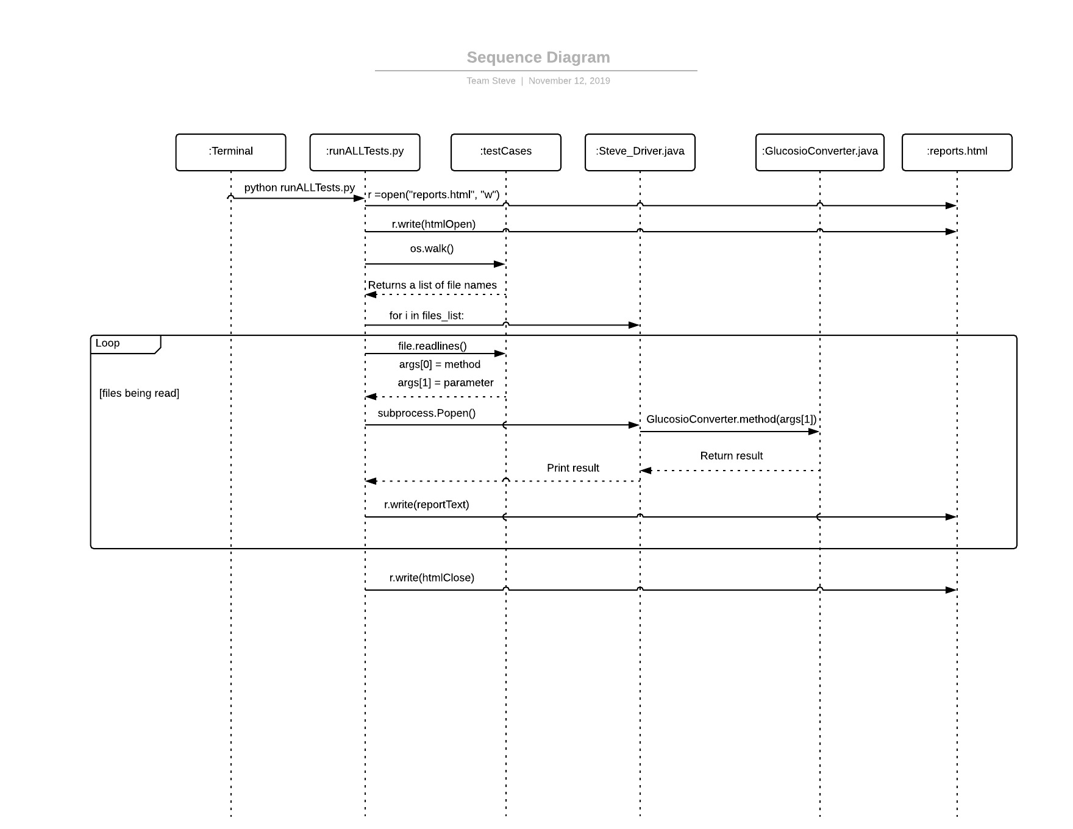
Our Process

Slide 3
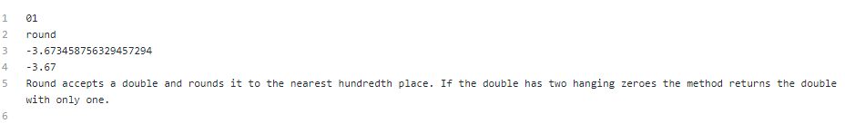
Test Case File
The test case files include:
Test ID
Method Name
Input value
Oracle
Description of the method

Slide 4
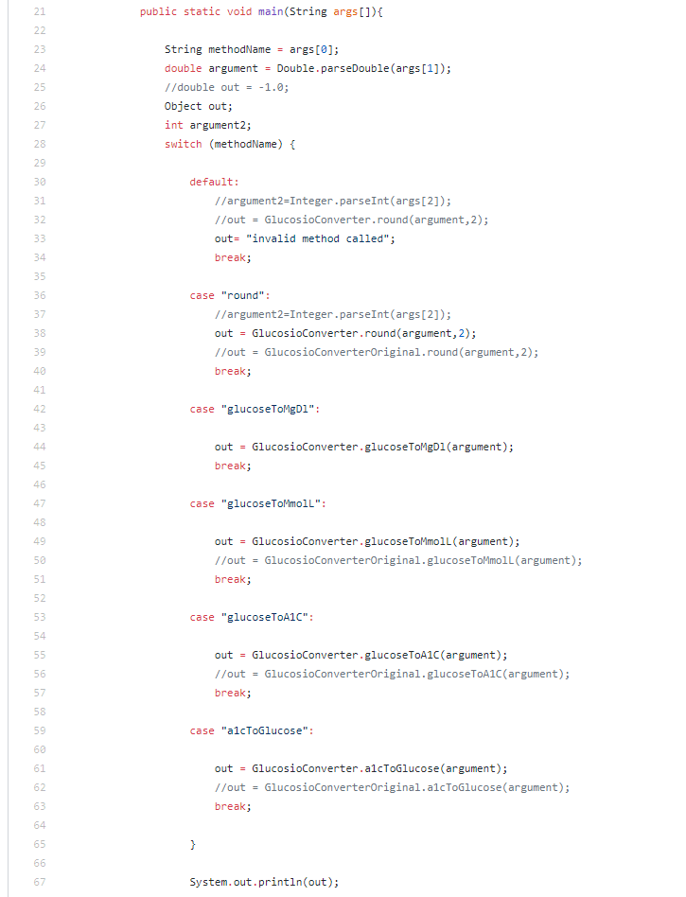
Driver
Our driver makes use of a switch statement to call the method indicated by the script. Because of this, the script can call the driver multiple times for each test case. The driver is fed the method name and the input, after which it creates an instance of the GlucosioConverter.java. The method is fed to the switch statement, which then calls the method from GlucosioConverter with the input given by the script.

Slide 5
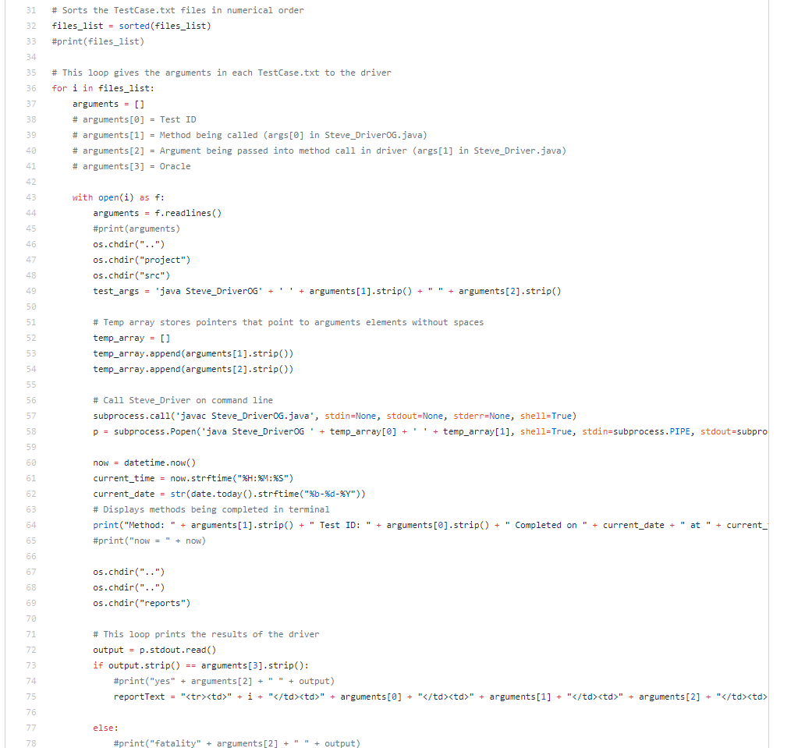
Script
Our script finds the test case folder, imports each file as strings, and sends the method name and input to the driver. Once the driver has called the method, it prints out the result. Our script captures the print results of the driver and compares it to the oracle, which it derives from the test case file. If it matches, the script reports it as a pass. Otherwise, it records it as a failure. The script then outputs the data to an HTML file and opens it up in the users preferred browser.

Slide 6
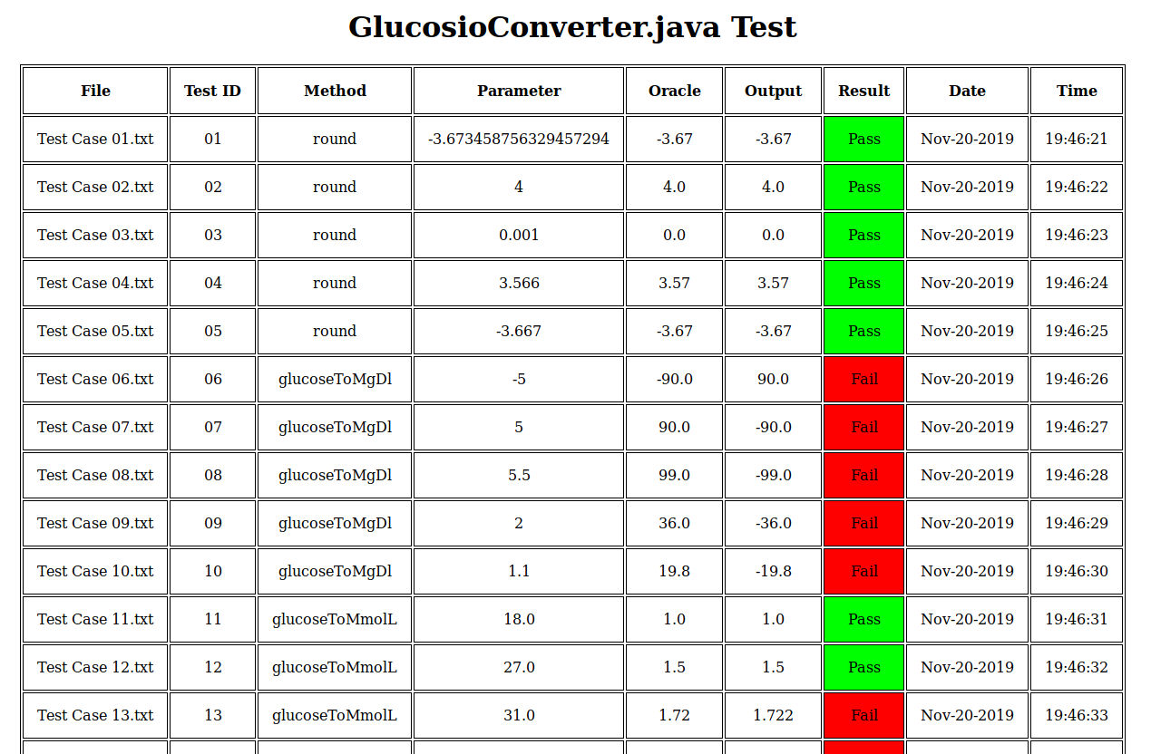
HTML
The HTML displays the output of our testing process. It includes the name of the test case file, the method tested, the TestID, the input, output, oracle, whether it passed or failed, and the timestamp.

Slide 7
Conclusion
In conclusion Team Steve completed our project quickly and efficiently. From day one we had a plan laid out for how our driver would look and what information our test cases would contain. We finished our deliverables well before their due date, largely due to the simplicity of our driver which gave us ample time to work on the script. Overall we each learned how to work as a team as well as how to utilize some of the more powerful tools included in Python and Java.

